Slide 1
Balancing Economic Growth and Environmental Sustainability:
A Data-Driven Analysis of Energy Consumption Patterns
Denise Becerra | Josh Dennis | Krish Viswanadhan Nair Kanak Sharma | Vishnu Sai Nandan Tummala

Slide 2


Introduction
Global economic growth increasingly challenges environmental sustainability.
This project examines how economic growth and energy consumption trends intersect, highlighting the role of sustainable practices in long-term development.
By analyzing indicators like World Development, Statistical Capacity, and Environmental metrics, the study will reveal patterns and assess energy consumption impact on GDP across countries.
Notes:
When facing the acceleration of global economic development, maintaining environmental sustainability is an increasing challenge.
This project seeks to explore the relationship between a nation's economic growth and its evolving energy consumption trends, emphasizing how sustainable practices can influence long-term development.
Using rigorous data analysis, key indicators like World Development, Statistical Capacity, and Environmental metrics will be leveraged to measure progress, uncover hidden patterns, and assess the impact of energy consumption on GDP growth across various countries.

Slide 3

Objective #1
Objective #2
Objective #3
Research Objectives
Analyze the relationship between economic growth, renewable energy adoption, and environmental outcomes, with special focus on emissions patterns and impact classifications.
Identify and classify countries based on development profiles, energy access, labor force characteristics, and key economic indicators such as GDP, trade, and domestic savings.
Evaluate how energy consumption trends influence CO₂ emissions per capita across nations and determine what influences the GDP of countries.

Slide 4
Objective #1
Objective #2
Objective #3
Research Questions
- Will rapid economic growth cause environmental degradation?
- How does the level of GDP growth vary with renewable energy use across high, moderate, and low impact classifications?
- Can we classify countries based on features related to energy consumption and GDP?
- What development profiles emerge across countries based on energy access and the Labor Force?
- How have individual countries transitioned toward renewable energy from and what are the patterns in CO₂ emissions per capita?
- How do foreign direct investment, exports, imports, and domestic savings influence a country’s GDP?
- How do renewable energy usage, electricity access rural vs urban, and forest area influence CO₂ emissions per capita?
Notes:
Back-up slides

Slide 5






Database Design
DB
Browser
World Development Indicators
Environmental Indicators
Economic Indicators
Time Table
Country with Time
(Assoc Entity)
Countries Table
Notes:
The source of all data used in this project came from World Bank.org, which was then compiled into a database using SQLite 3. Once queried, additional analysis was conducted with python.
All data retrieved from WorldBank.org came from the World Development Indicators database. Indicators were selected independently be each analyst, then compiled into a complete database, with all series agreed upon as a team. These variables were then sorted into two separated tables, Environmental and Economic Indicators. Two additional tables were created, Time and Countries, which together created a Country with Time Associative Entity. This entity was used as the primary keys to query between both tables.

Slide 6
Methodology
DATA PREPARATION
FEATURE ENGINEERING
MODELING, CLUSTERING & ANALYSIS
VISUALIZATION & INTERPRETATION
Explored trends and multicollinearity using EDA, heatmaps, and VIF to retain key features.
Used clustering and PCA to explore patterns; built regression and classification models for insights.
Visualized trends with scatter plots, bar charts, dendrograms, and time series to uncover country-level patterns.
Merged key indicators, handled missing data, and prepared features for analysis.
Notes:
We started with Data Preparation, encountered missing values, used forward and backward filling techniques, also applied feature scaling to ensure comparability between variables
Next, in Feature Engineering, performed Exploratory Data Analysis, checked for multicollinearity using correlation heatmaps and the Variance Inflation Factor, removing redundant features to enhance model clarity.
Once the data was clean and refined, we moved to Modeling and Clustering. We normalized the features and applied K-Means Clustering to group countries based on energy transition patterns. To visualize this in two dimensions, we used Principal Component Analysis. The resulting clusters were labeled as Fast, Moderate, and Slow Adopters of renewable energy.
Visualized trends with scatter plots, bar charts, dendrograms, and time series to uncover country-level patterns

Slide 7
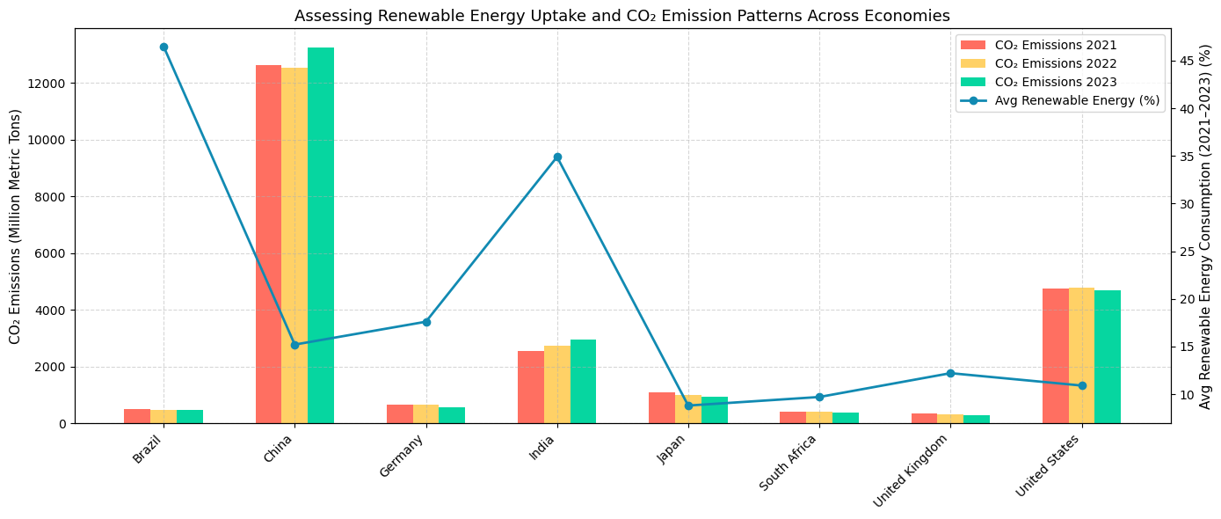
Exploratory Data Analysis
Renewable Energy Transition vs CO₂ Emissions: A Country-Level View (2021–2023)
High Renewable Adoption Correlates with Lower Emissions- as seen in Brazil and Germany.
Rapid Emission Growth Despite Progress- despite moderate renewable growth, U.S. and China rely on fossil fuels, driving emission increases
Developed Nations Show Mixed Patterns: Gradual, uneven shifts in U.K. and Japan energy trends.
Notes:
Vishnu
High Renewable Adoption Correlates with Lower Emissions- as seen in Brazil and Germany.
Rapid Emission Growth Despite Progress- despite moderate renewable growth, U.S. and China rely on fossil fuels, driving emission increases
Developed Nations Show Mixed Patterns: Gradual, uneven shifts in U.K. and Japan energy trends.

Slide 8
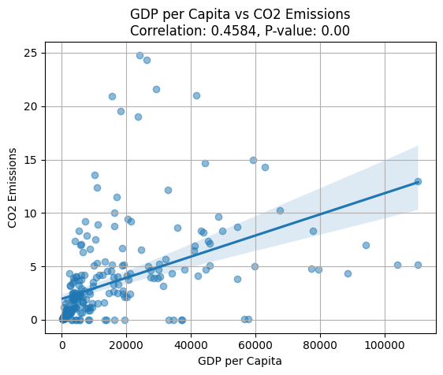
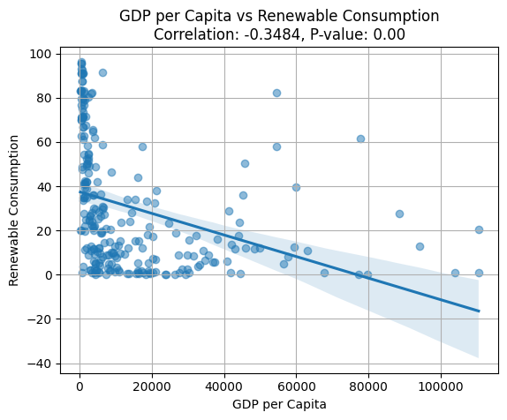
Hypothesis Testing
Comparing CO₂ Emissions vs GDP per Capita & Renewable Energy Transition vs GDP per Capita
CO₂ Emissions:
P-value: 0.00
Correlation Coefficient: 0.4584
Renewable Transition:
P-value: 0.00
Correlation Coefficient: -0.3484
Notes:
Vishnu
First the relationship between CO2 emissions and GDP growth was tested to examine if high production led to higher emissions. With a p-value of 0.00, there is clearly a statistically significant relationship between Co2 emissions and GDP. The correlation coefficient of 0.4584 shows a strong to moderate positive linear relationship. Therefore, as GDP increases, as does Co2 emissions.
We then tested the relationship between renewable energy adoption and GDP growth. Again producing a p-value of 0.00, or a statistically significant relationship. However, this relationship has a correlation coefficient of -0.3484, indicating a moderate negative relationship between the variable. As GDP increases, renewable energy usage decreases.

Slide 9
Objective #1
Analyze the relationship between economic growth, renewable energy adoption, and environmental outcomes, with special focus on emissions patterns and impact classifications.

Slide 10
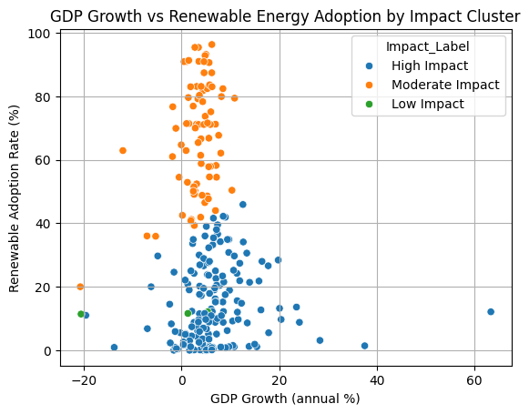
XGBoost Analysis
Rapid Economic Growth vs. Environmental Degradation
High Impact: >10% GDP growth, <30% renewables
→ high environmental strain.
Moderate Impact: High renewables,
→ moderate/negative GDP growth.
Low Impact: Fast growth with low renewable investment → environmental risk.
Few countries achieve both strong growth and high sustainability, revealing a growth vs. green trade-off in current global trends.
Notes:
Kanak
No strong global linear trend, but visible group patterns (clusters) based on sustainability behavior.
labels like 'High Impact' to each cluster based on which has the highest CO₂ increase + GDP + low renewables.
Thus,
High-growth countries tend to have low renewable adoption, while countries with high renewables exhibit moderate to low economic growth, indicating a potential trade-off or transition phase between economic expansion and sustainable energy integration.

Slide 11
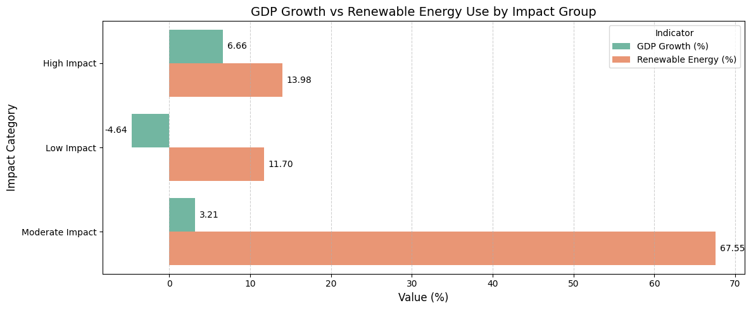
Random Forest
GDP Growth vs Renewable Energy Use by Impact Classification
Each bar shows the average percentage for GDP growth and renewable energy adoption per group.
High Impact: Rapid growth driven by fossil fuels — high environmental cost.
Moderate Impact: Balanced growth with strong investment in renewables.
Low Impact: Economic and environmental decline, often due to instability or outdated infrastructure.
Finding: Sustainability and growth can coexist — as shown by the Moderate Impact group.
Notes:
Kanak
High Impact: Countries are growing fast, but their growth is likely fossil-fuel-driven, leading to higher environmental impact.
Moderate Impact: Countries with balanced progress —growing economically while heavily investing in sustainable energy, reflecting green growth leadership.
Low Impact: Countries are struggling both economically and environmentally, with low renewable adoption and shrinking economies
— likely due to instability, outdated energy infrastructure, or conflict.
high GDP growth (around 6.65%), indicating fast economic development. However, the renewable energy share is relatively low (~13.96%), suggesting that growth is still heavily reliant on fossil fuels
these countries have a very high renewable energy usage (67.5%) on average! However, GDP growth is modest (only 3.21%), suggesting a slower but more sustainable development model.
countries have low GDP growth (1.46%) and moderate renewable energy usage (11.7%). It may indicate mature or stagnant economies with limited expansion, but also not much increase in renewable adoption.

Slide 12
Objective #2
Identify and classify countries based on development profiles, energy access, labor force characteristics, and key economic indicators such as GDP, trade, and domestic savings.
Notes:
-To determine groups of countries with factors related to gdp and energy consumption patterns, we used cluster analysis, opposite to kanak’s supervised learning classification models

Slide 13
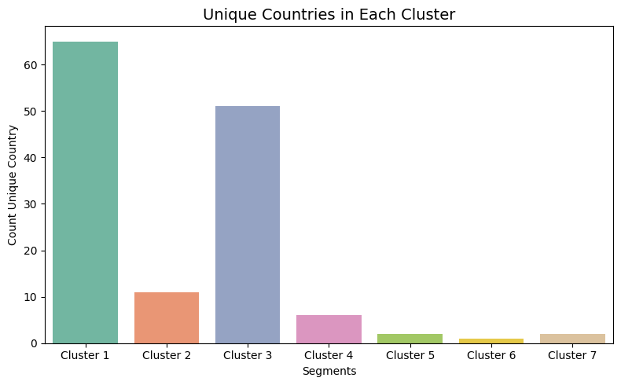
Hierarchical Cluster Analysis
Classifying Countries on GDP & Energy Consumption
Number of Clusters: 7
Cluster 1 has more than 60 countries segmented
Top 5 countries in each cluster
Findings: China and United States clustered together by determining factors like GDP, Electric Power Consumption, and Fossil fuel consumption
Notes:
Denise
-From this we were able to determine 7 segments were necessary for this hierarchical analysis
-Cluster 1 and 3 having the most countries segmented based on key features.

Slide 14
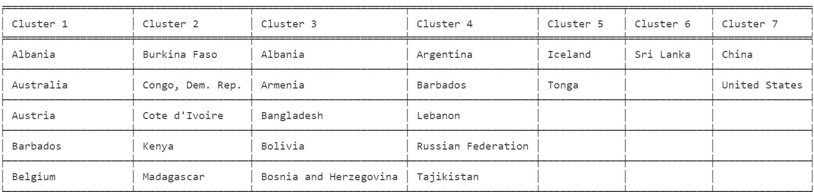
Hierarchical Cluster Analysis
Classifying Countries on GDP & Energy Consumption
Number of Clusters: 7
Cluster 1 has more than 60 countries segmented
Top 5 countries in each cluster
Findings: China and United States clustered together by determining factors like GDP, Electric Power Consumption, and Fossil fuel consumption
Notes:
Denise
-This second graph shows the top 5 countries in each cluster for ease of readability
-Some key findings show that China and the US were clustered together due to their similarities in GDP, Electric power consumption and fossil fuel consumption when using unsupervised learning models

Slide 15
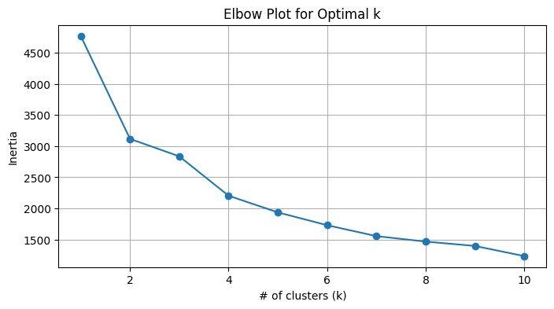
K-Means Cluster Analysis
Profiling Countries on Labor Force & Access to Energy
Number of clusters: 2
Graph: Determining Optimal K or number of Clusters
Findings: Countries like Austria and Belgium show similarities in Labor Force and Access to electricity
Note: Congo has a high labor force and low access to electricity opposite to other countries (outlier)
Notes:
Denise
-When analysing additional data to create segments using K-means Clustering, 2 clusters were created as shown on this here
- 1st Graph visualizes the optimal number of clusters for the analysis
-only 2 were selected due to the fact that adding more clusters past the most prominent elbow break reduces how
well the clusters are formed challenging the integrity of the predictive model.

Slide 16
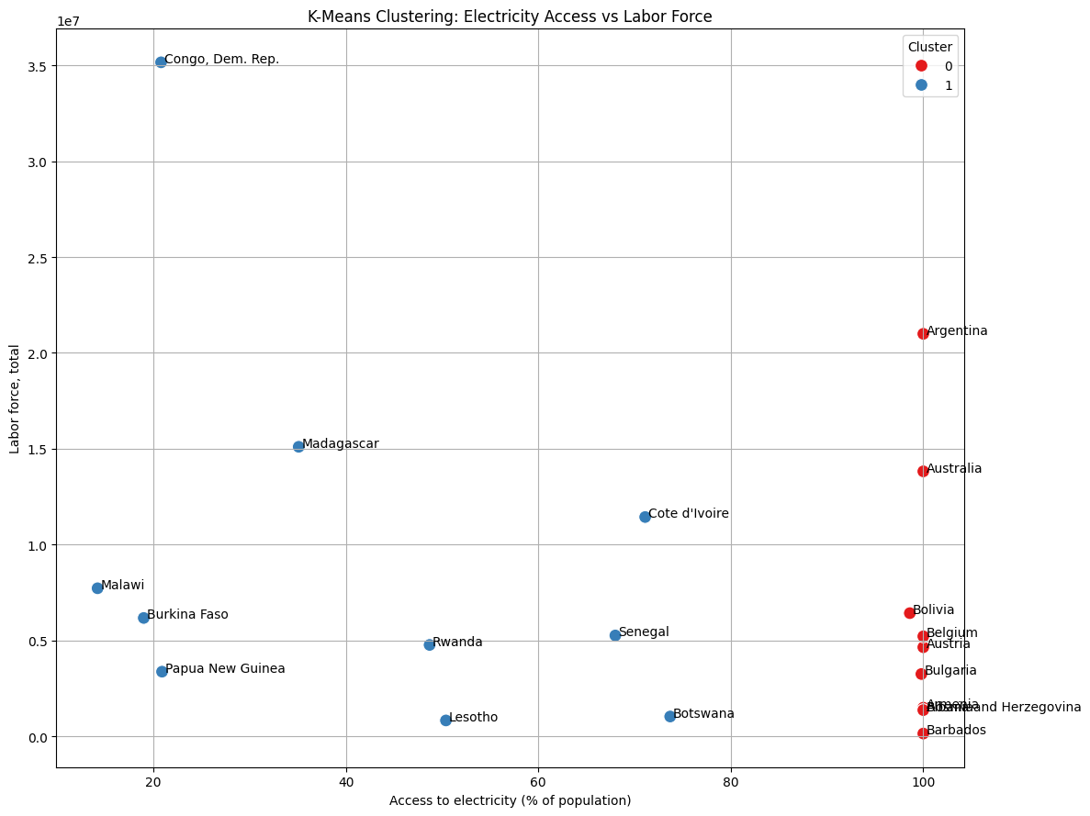
K-Means Cluster Analysis
Profiling Countries on Labor Force and Energy Access
Number of clusters: 2
Graph: Countries on each cluster by Labor Force (% of pop) and Access to electricity (% of pop)
Findings: Countries like Austria and Belgium show similarities in Labor Force and Access to electricity
Note: Congo has a high labor force and low access to electricity opposite to other countries (outlier)
Notes:
Denise
- This 2nd graph show the top 10 countries in each cluster after the analysis was completed
-Key findings include: Austria and Belgium were grouped together because of their similarities in their labor force and access to electricity
-A result of interest: shows that although Congo is grouped in the second cluster, it has a high labor force with low access to electricity opposed
to other countries in the same segment, most likely due to its lack of infrastructure and the sociopolitical issues the country has. Classifying it as an outlier.

Slide 17
Objective #3
Evaluate how energy consumption trends influence CO₂ emissions per capita across nations and find what influences the GDP of countries.
Notes:
For our Objective #3
We are going to Evaluate how energy consumption trends influence CO₂ emissions per capita across nations and find what influences the GDP of countries.

Slide 18
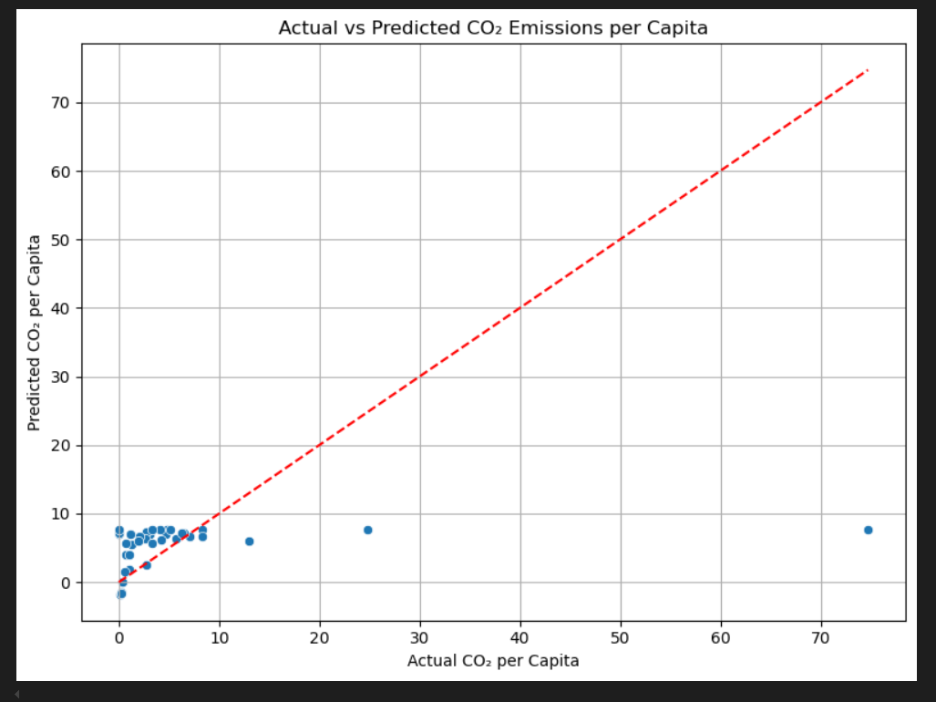
Multiple Regression Analysis
Renewable Energy Usage, Electricity Access, & Forest Area vs. CO₂ Emissions per Capita
Predictor variables: Renewable Energy Usage, Electricity Access, & Forest Area
Target variable: CO₂ Emissions per Capita.
Findings: The model shows that renewable energy usage and rural electricity access reduce CO₂ emissions, while urban access and forest area slightly increase it, overall indicating variations in CO₂ emissions per capita, and a need for additional features to improve accuracy.
Graph : Outliers like China and the US strongly affect model accuracy
R² Score: 0.3696
Notes:
Krish
Our objective here was to find how our predictor variables like renewable energy usage, electricity access(both urban and rural), and forest area can influence CO₂ emissions per capita which is our target variable.The model was trained on a dataset extracted from the environmental indicators table. Our findings show that renewable energy usage and rural electricity access reduce CO₂ emissions, while urban access and forest area slightly increase it, overall indicating variations in CO₂ emissions per capita, and a need for additional features to improve accuracy as we can see in the graph that Outliers like China and the US strongly affect model accuracy with R² of 0.3696

Slide 19
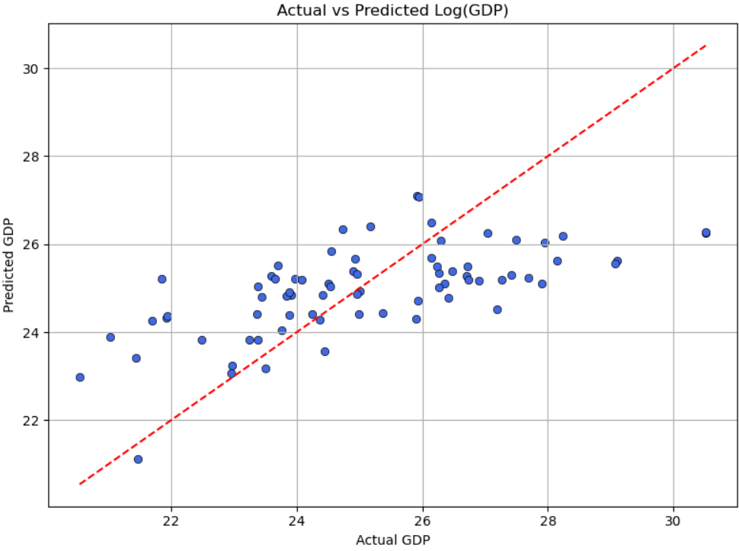
Multiple Linear Regression
Foreign Direct Investment, Exports, Imports, and Domestic Savings influence on a country’s GDP
Predictor variables: FDI, exports, imports, and gross domestic savings
Target Variable : GDP
R² Score: 0.3822
Graph: Many points are clustered close to the red line, indicating reasonably accurate predictions
Notes:
Krish
Here we examine how the the predictor variables like FDI, exports, imports, and gross domestic savings, influence a country’s overall GDP as the target variable in current U.S. dollars. The data was sourced from the economic indicators table for the multiple linear regression (MLR) model. As you can see in the graph many points are clustered close to the red line, indicating reasonably accurate predictions with a R² value of 0.3822.

Slide 20
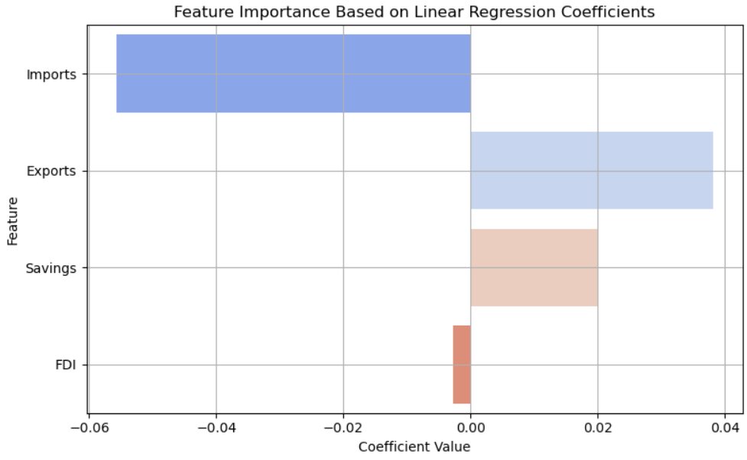
Linear Regression
Foreign Direct Investment, Exports, Imports, and Domestic Savings influence on a country’s GDP
Findings:
Imports have the strongest (negative) impact on GDP in the model.
Exports and Savings are positively associated with GDP.
FDI seems less significant in this dataset or model context.
Notes:
Krish
Looking at the feature importance graph ,we can see that Imports have the strongest (negative) impact on GDP.Exports and Savings are positively associated with GDP and FDI seems less significant in this model context.From our findings we can conclude that Domestic Savings and Imports are directly proportional with GDP. No surprises there.

Slide 21
Objective #1
Objective #2
Objective #3
Conclusion
Economic growth and renewable energy adoption is possible as we see countries like Germany and Brazil are successfully moderating both.
We found China and United States are outliers by determining factors like
high GDP, Electric Power Consumption, Fossil fuel consumption and CO₂ emissions.
While Exports and Domestic Savings directly influenced the GDP of a country, Urban Electricity Access
was a top contributor
CO₂ emissions, apart from fossil fuels.
Finally, across all three objectives, our results emphasize the urgent need for balanced development strategies that align economic ambition with environmental responsibility.
Notes:
"Let’s now conclude our findings by revisiting the three key objectives of our research.
For Objective #1, we examined the relationship between economic growth and renewable energy adoption. Encouragingly, we found that sustainable growth is achievable — countries like Germany and Brazil are leading examples. They show that it is possible to grow economically while actively integrating renewable energy into national policy.
In Objective #2, our analysis highlighted China and the United States as major outliers. What sets them apart are consistently high levels of GDP, electric power consumption, fossil fuel dependency, and correspondingly high CO₂ emissions. These factors make them unique in terms of their global environmental impact.
Objective #3 revealed something very interesting — while traditional economic indicators like exports and domestic savings did influence GDP, we also discovered that urban electricity access plays a critical role in shaping CO₂ emissions. This finding emphasizes how infrastructure and access contribute to environmental outcomes, especially when fossil fuels are involved.
Finally, across all three objectives, our results emphasize the urgent need for balanced development strategies. It’s not enough to focus on economic output — we need policies that align economic ambition with environmental responsibility. Only then can we build resilient, future-ready economies."

Slide 22
Thanks!
Notes:
Vishnu

